Slide 1

.NET LINQ
Ejaz Ahmed
(RPA Developer)

Slide 2

Agenda
Overview of LINQ
Syntax Styles
Benefits
Use Case

Slide 3
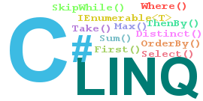
LINQ Overview
LINQ stands for Language Integrated Query.
It's a feature of .NET that allows you to query data from different data sources using a unified syntax.

Slide 4



Syntax Styles
Method Syntax
Query Syntax

Slide 5
Benefits
Simplicity : LINQ provides a simplified syntax, making it easier to write and understand complex queries.
Less Code : Multiple/nested loops are replaced with more compact form
Querying Multiple Data Sources: XML ,Json , Array, list, data table

Slide 6

LINQ Use Cases

Slide 7
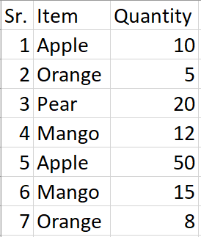
Use Case1
In your fruit data table, you have to retrieve the quantity value associated with the last occurrence of 'Mango

Slide 8
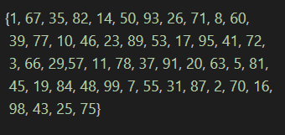

Use Case2
You have an array of 50 numbers ranging from 1 to 100. You have to output all the numbers in the array that are greater than a specified number provided by the user

Slide 9
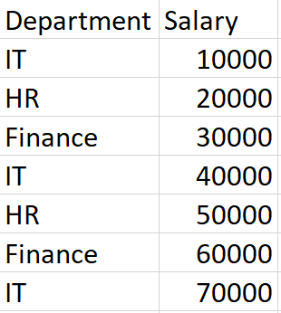

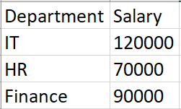
Use Case3
In data table, which contains departments and their corresponding salaries, your task is to calculate the total salary for each department.

Slide 10

Thank You

